Slide 1
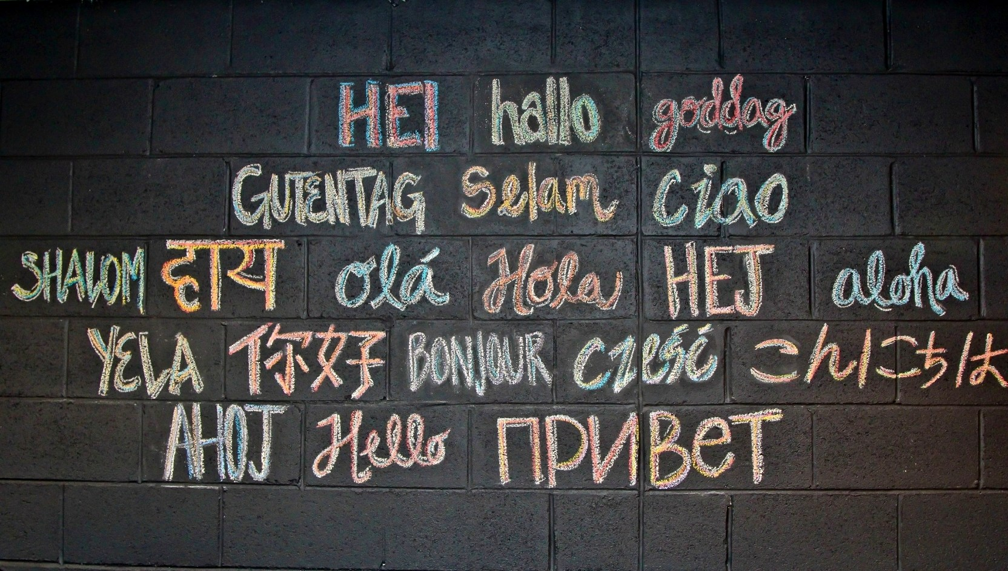
Notes:
Wall at Urban Butcher restaurant

Slide 2
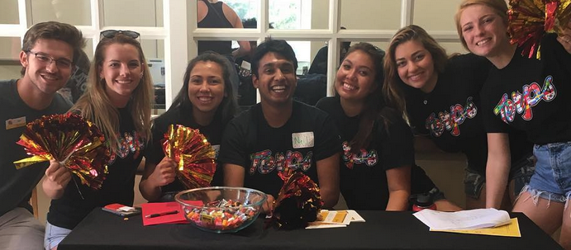
Welcome to the Global Communities Living-Learning Program

Slide 3
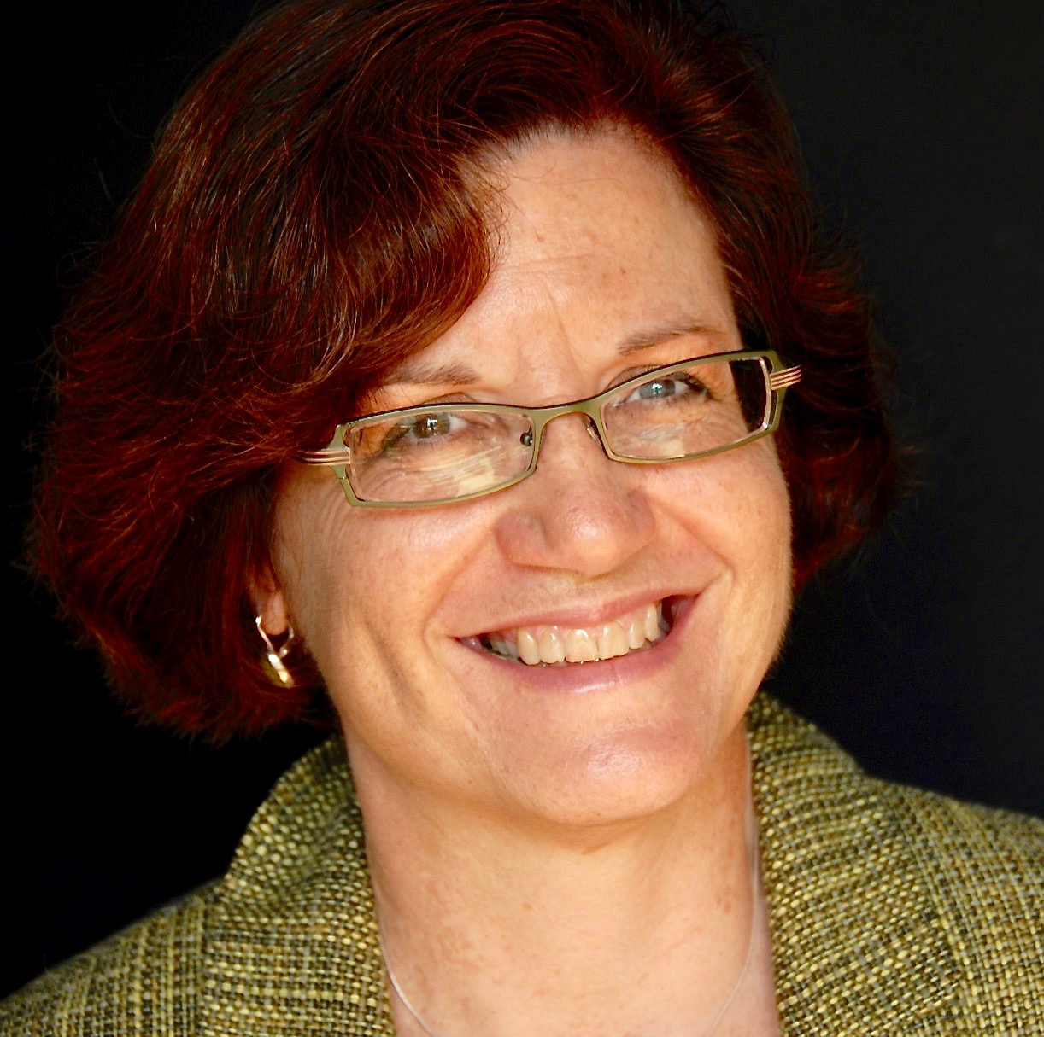
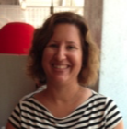
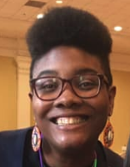
Introductions
Dr. Virginia Haufler
Faculty Director
Natalie Vinski Ibrahim
Associate Director
Jamila Aswad
Program Manager

Slide 4
What is a Living-Learning Program?
Learning communities combine academic curriculum with residential life
Coherent thematic programs
Community=
Collaboration/ communication
Smaller college within a college on a big campus
Experiential learning outside the classroom
High impact on student learning and success

Slide 5
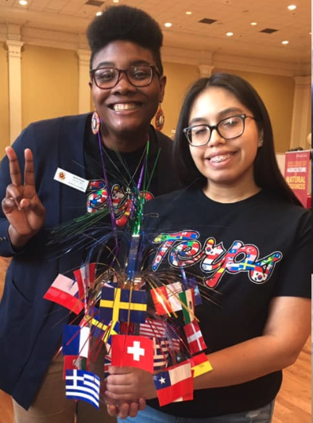
Global Communities
We are a Living-Learning Community
We are a Global Studies program combining courses and events/ activities
We are an interdisciplinary program open to all majors
We are faculty and staff dedicated to your success
We want you to experience the world on campus, in Washington, and abroad
Notes:
Mission:
Overview of structure:

Slide 6
Goals of the Program
Understand the causes and consequences of globalization, and
the trends and issues that shape our lives
Develop your own perspective through study + experience
Gain/ practice skills for communicating and collaborating with
people from different cultures and backgrounds
Learn about resources + leadership opportunities
that contribute to success in college and career

Slide 7
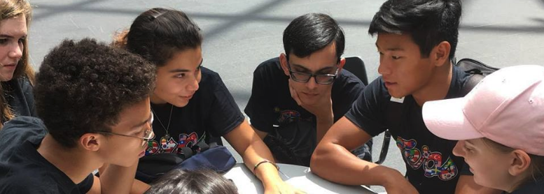
Our Values
Intellectual curiosity and commitment to learning
Respect and empathy for people with different
backgrounds and beliefs
Desire to engage with the world and contribute to a
sustainable future for all
SERVICE DAY IN LANGLEY PARK

Slide 8
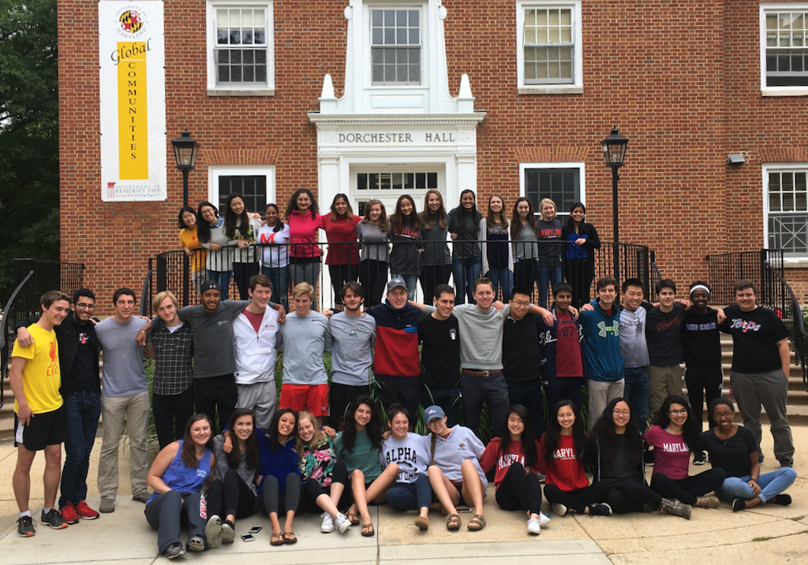
Home: Dorchester Hall
SERVICE DAY IN LANGLEY PARK

Slide 9
Program
FIRST YEAR
Live in Dorchester
Take 3 courses/ 7 credits
Participate + engage in program
SECOND YEAR
(optional) Live in Dorchester
Arrange 3 credit experiential course
Submit capstone
Participate + engage in program
Earn a Notation on your transcript

Slide 10
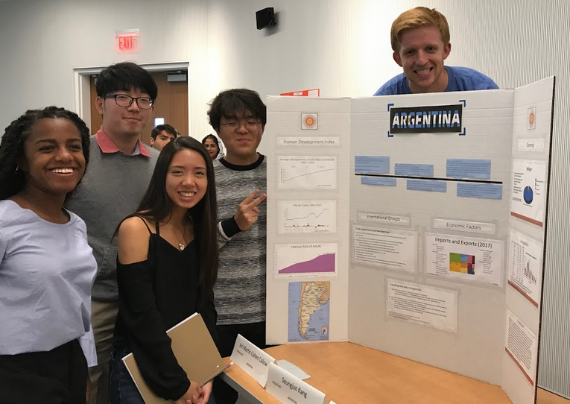
First Year Courses
BSGC100 Introduction to the University and Global Communities
(1 credit)
BSGC101 Globalization
(3 credits) (Gen Ed)
BSGC102 Global Issues (3 credits) (Gen Ed)

Slide 11
Second Year: Global Experience Course Options

Slide 12
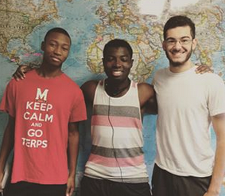
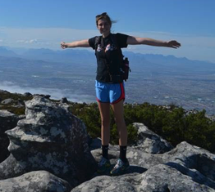
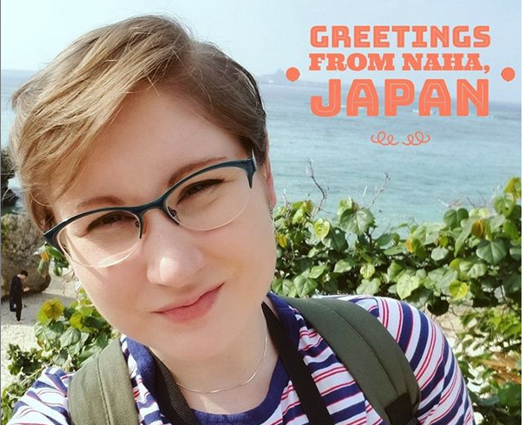
Option #1: Education Abroad
Short-Term Courses by UM faculty
Semester Abroad—both UM and others
Global Communities Grants

Slide 13
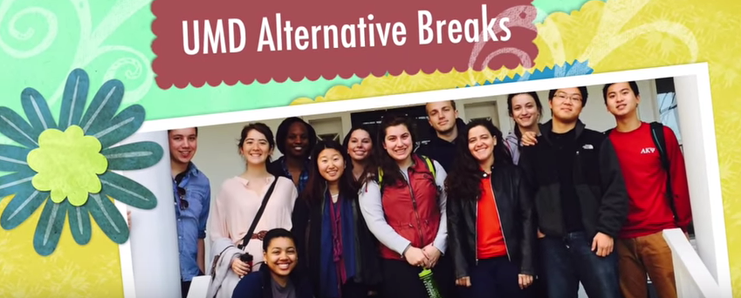
Option #2: Service-Learning
Participate in approved non-credit Alternative Breaks program in US or abroad OR other service experience + 3-credit course we offer on service-learning
ASB NASHVILLE TN

Slide 14
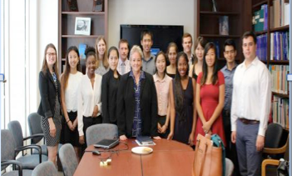
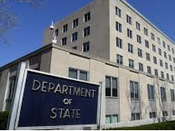
Option #3: Internship
United Nations Association
International Rescue Committee
Brazil Industries Coalition
Council on Foreign Relations
Muslim Community Center (MCC) Medical Clinic
Global Digital Infrastructure Alliance
Food Policy Research Institute
MURI Interaction Project – UMD
American Psychological Association Excell Sports, Inc.
START
Robinzonda English Immersion Summer Program-Russia
American Jewish Coalition, Atlanta, GA
HarvestPlus International

Slide 15
Option #4: Relevant experiential courses on campus
Approved UM courses that include experiential activity with a global orientation
Example: certain courses from the campus Do Good Institute

Slide 16
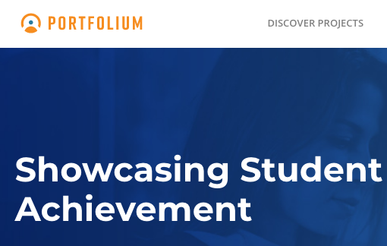
The Global Capstone

Slide 17
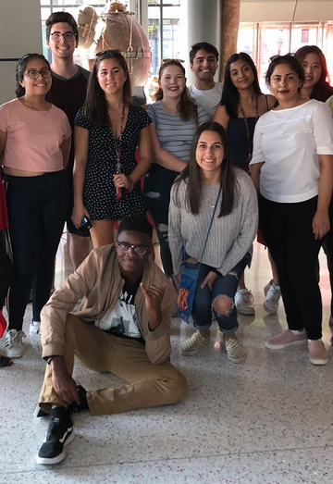
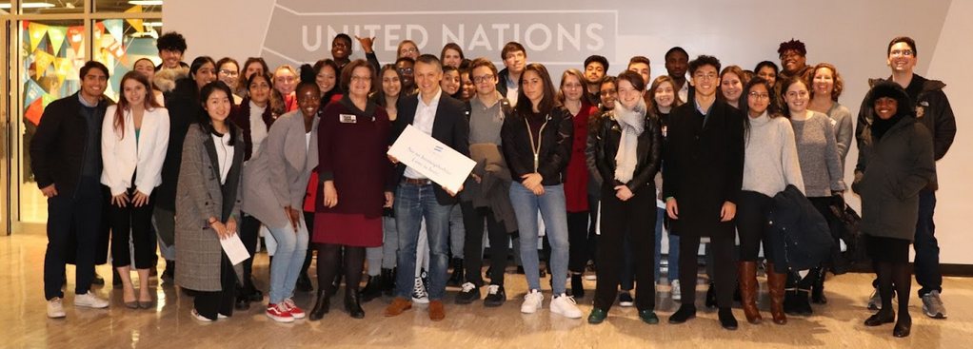
US HOLOCAUST MEMORIAL MUSEUM
Field Trips:
United Nations, International Spy Museum
LIBRARY OF CONGRESSS

Slide 18
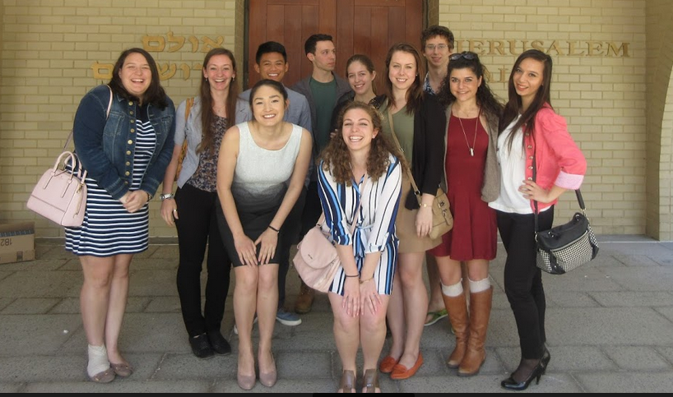
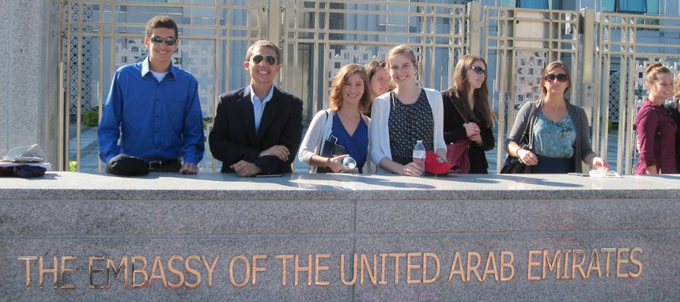
Embassies, Agencies, Cultural Centers

Slide 19
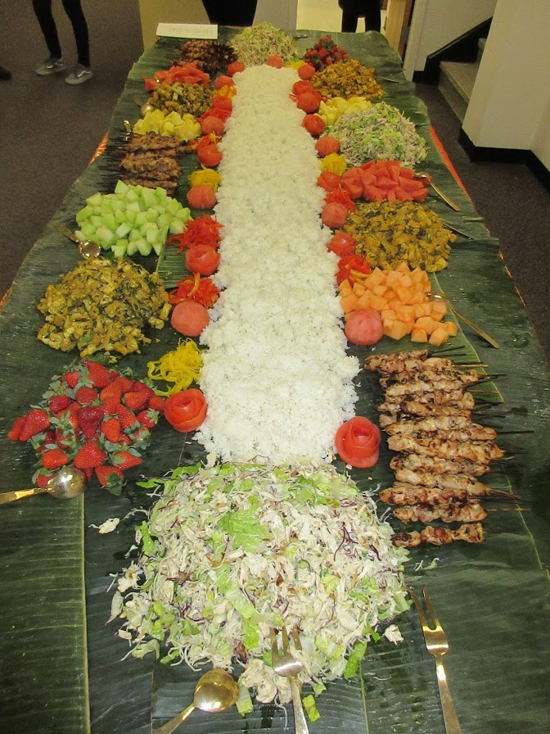
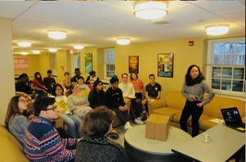
Korean Culture Night
Culture Night
Cambodian Culture Night
Japanese Culture Night
Brazilian Culture Night
Filipinx Culture Night with Dr. Padios
Day of the Dead Celebration
Greek Culture Night

Slide 20
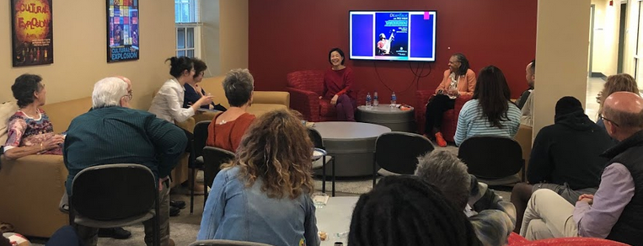
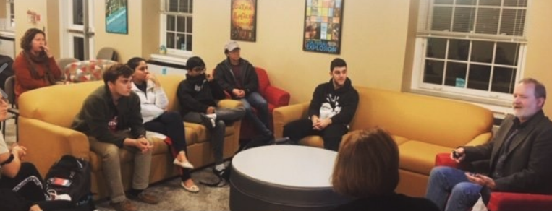
Global Conversations
Dean’s Talks

Slide 21
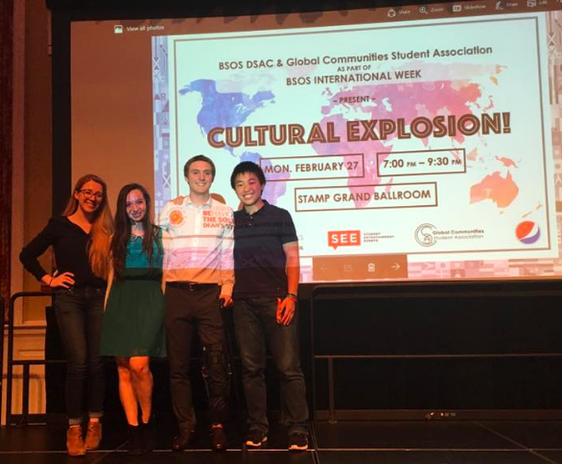
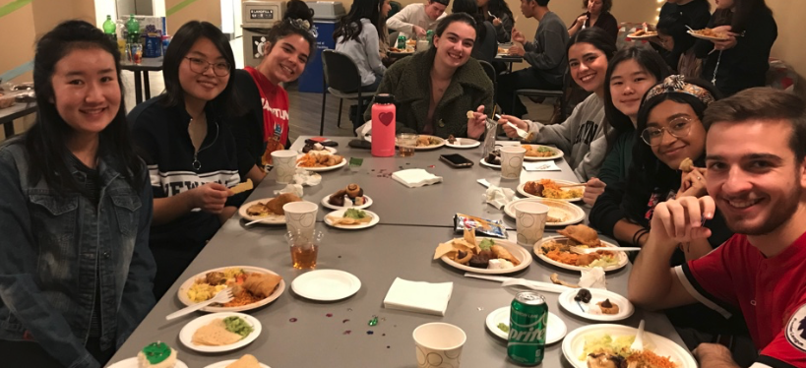
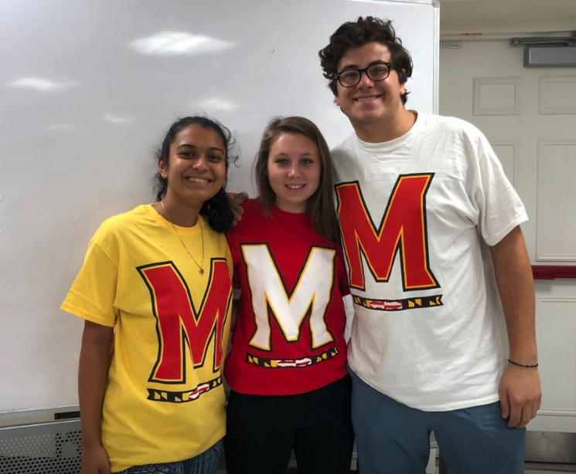
Global Communities Student Association
INTRAMURAL SOCCER

Slide 22
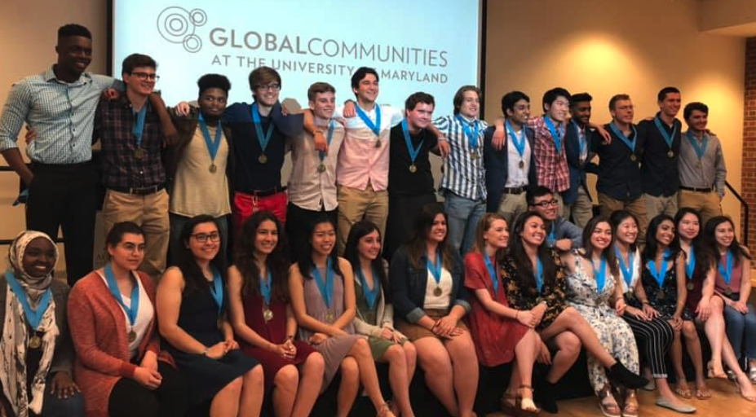
Celebration!
GRADUATION!

Slide 23
Why were you invited??
Academic achievement
Interest in world affairs and/ or other cultures
International background, experience, or family
ties
Open mind and community spirit
Generally interesting person!

Slide 24
Why join?
Interest in learning about the world
Small community on a big campus
Fulfill General Education course requirements
Skills and support for success
Alumni network
Global skills transcript notation
Great faculty and staff
It’s fun!

Slide 25
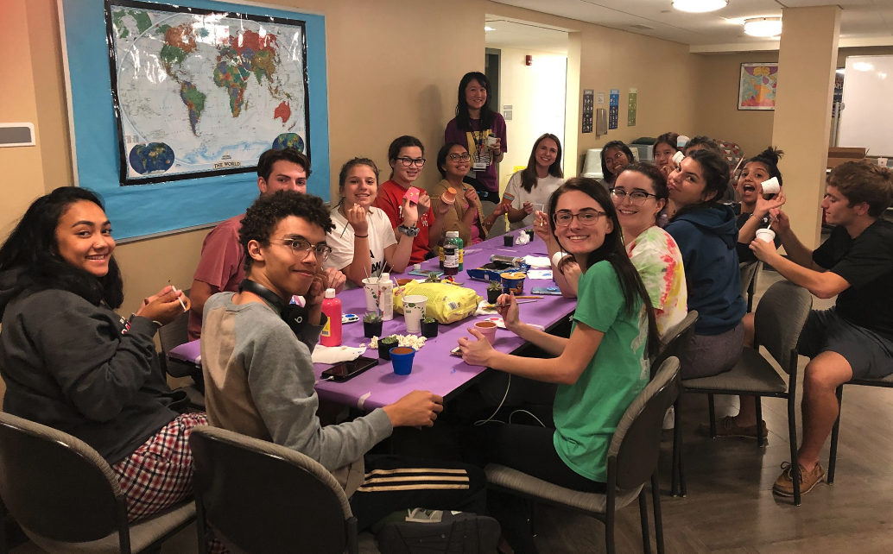
Join Us!

Slide 27
QUESTIONS??

